Slide 1

Futurense
Democratizing Tech Talent to deliver impact at scale

Slide 2
Health Care Analysis
- Narendra Reddy

Slide 3
Overview
Brief Description India's healthcare sector is a crucial area that demands attention to improve the country's present condition. Unfortunately, the current healthcare facilities in India are inadequate for the country's growing population. The existing facilities fall short of the necessary requirements, which highlights the need for an in-depth analysis of the situation. To address this need, our project aims to analyze the country's healthcare requirements by utilizing data from multiple sources, such as Census, Hospitals, Housing, and Government Hospitals. By leveraging these datasets, we hope to develop insights that can contribute towards improving the country's healthcare sector. Business Problem 1. Identify states with a shortage of hospital beds relative to their population (Beds count) 2. Determine which states have the most urgent need for new hospital installations 3.Number of Hospitals required in each state to meet the WHO standards

Slide 4


Tools and Technologies Used:

Slide 5





Libraries/Packages/Features Used:
Pandas
Numpy
Seaborn
Matplotlib
GeoPandas

Slide 6
Headline Statistics (1/2):
Lines of Codes (LoC/KLoC) : 290
Total number of functions :50
Number of built-in functions used :42
Number of user-defined functions used :8

Slide 7
Headline Statistics (2/2):
IDE/Code Editor Used :Jupyter notebook
Function/Complexity breakdown:
Simple Implementations
Intermediate Implementations
Complex Implementations

Slide 8
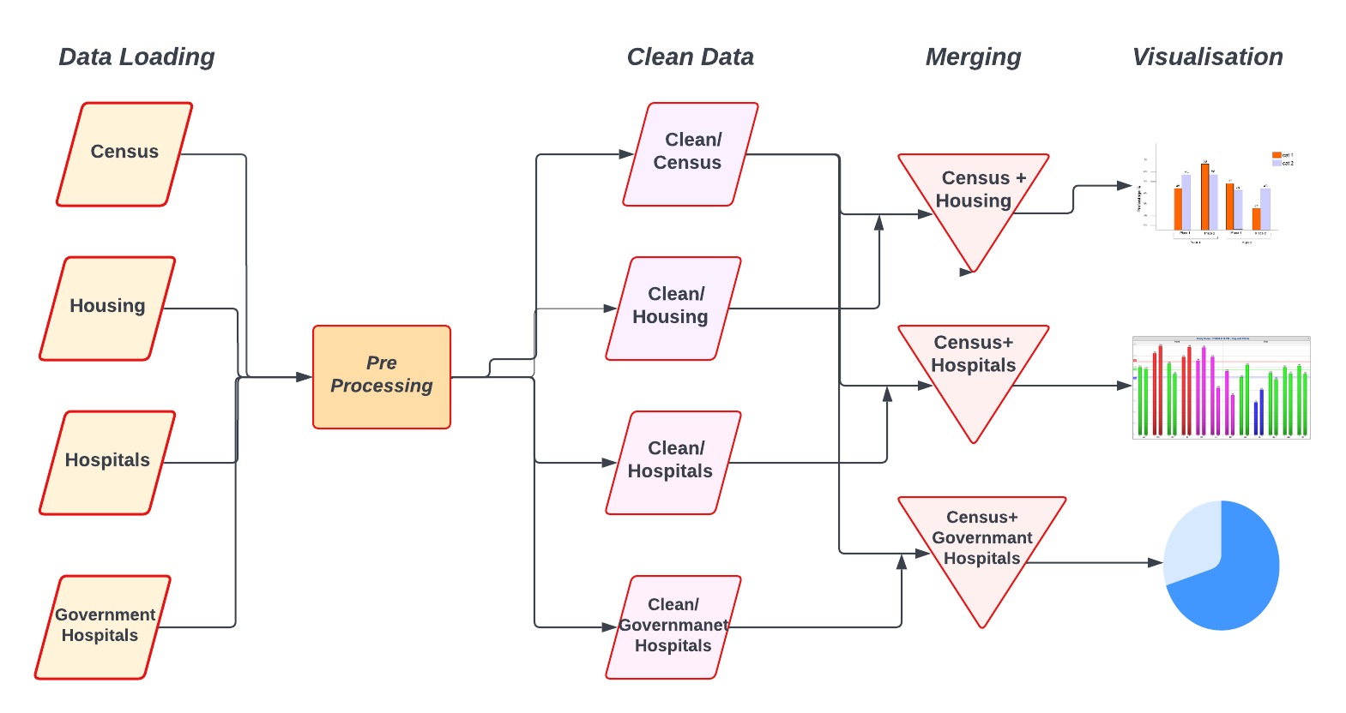
General Flow Diagram

Slide 9
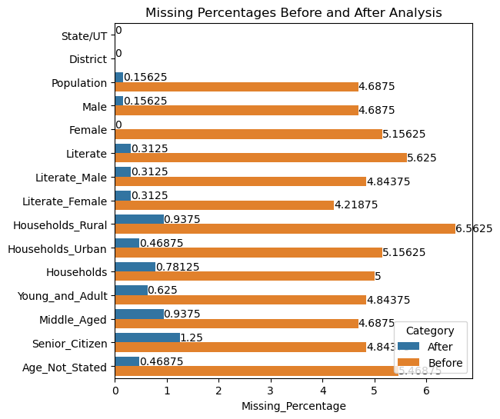
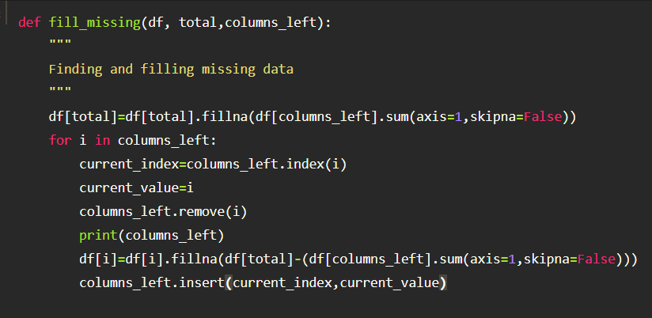
Pre Processing-Filling missing data in Census

Slide 10
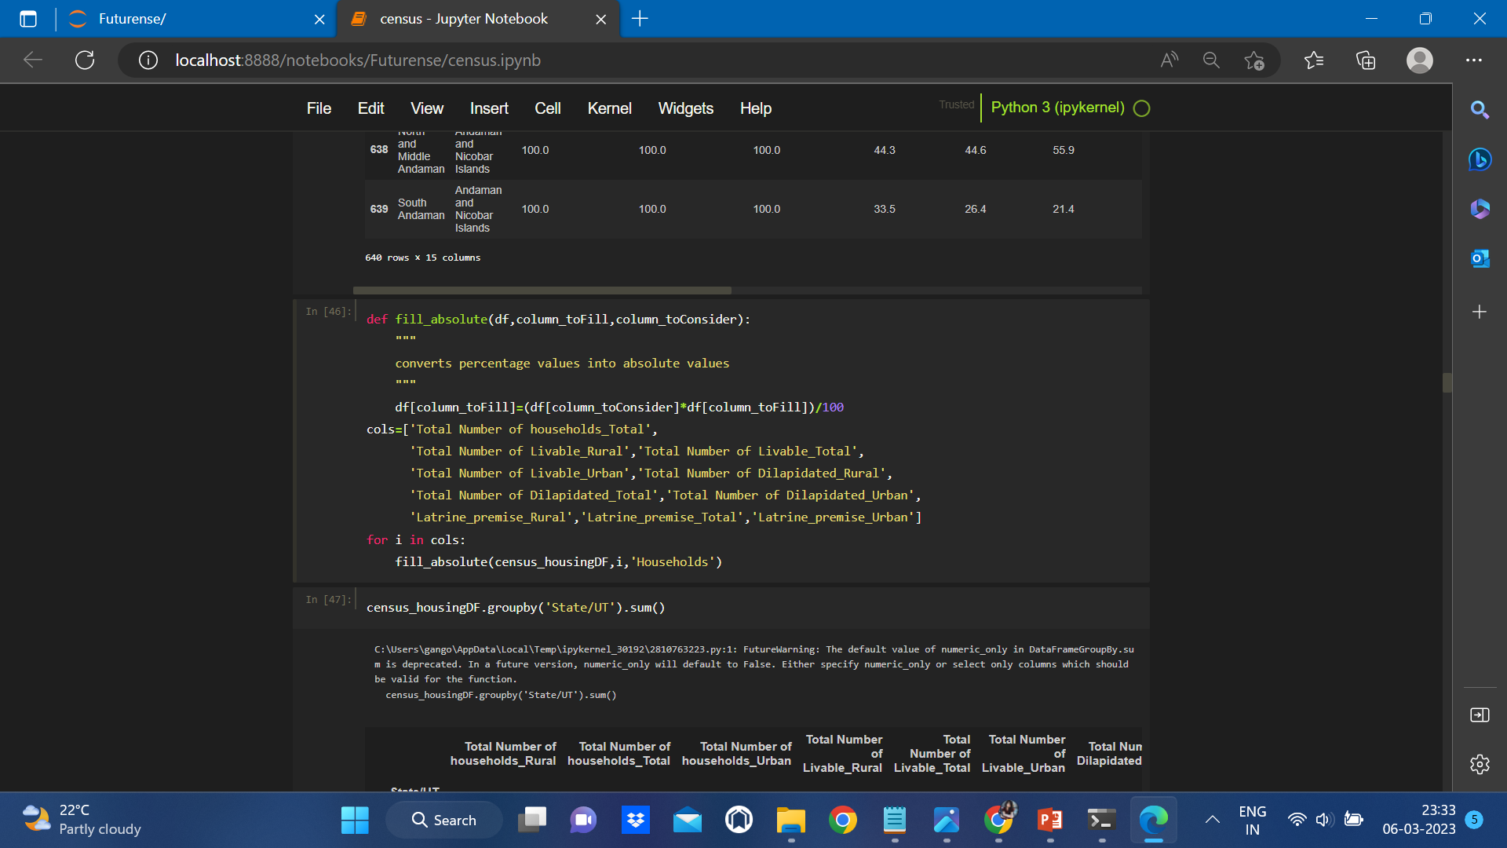
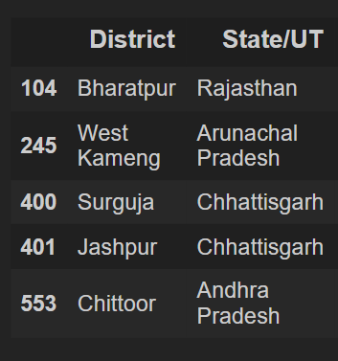
Housing Data(Districts with missing data)
Preprocessing
Remove irrelevant data to reduce noise and increase the efficiency of data analysis.
Rename columns and state names for consistency and ease of interpretation.
Merge Housing Data with Census Data based on Districts to gain insights into housing conditions and population characteristics.
Convert percentages to absolute values for greater clarity and ease of analysis.

Slide 11
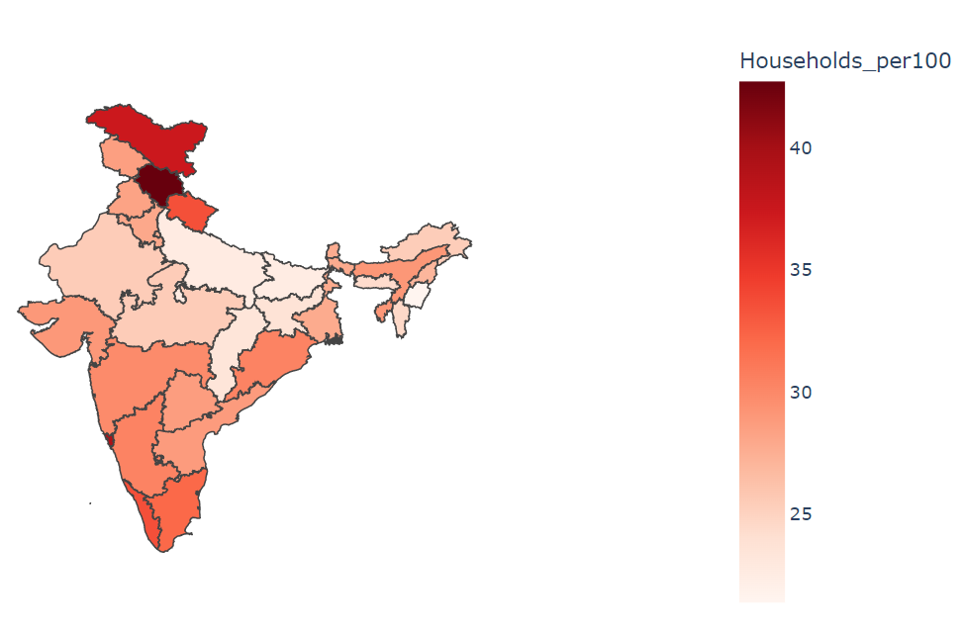
State-wise distribution of Households per 100 people
States with minimum number of Households Per 100 people
Manipur
Bihar
Uttar Pradesh
It is important to note that low household availability can lead to overcrowding and poor living conditions
Therefore, understanding the housing situation in different states can help policymakers to improve housing availability and promote better health outcomes for all citizens

Slide 12
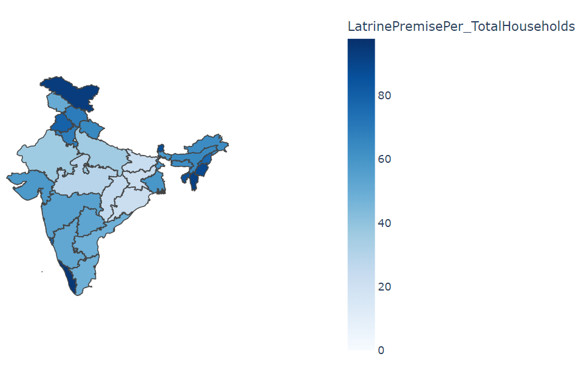
State-wise distribution of Households with toilets in Premise to total number of Households
States with lowest percentage of toilets in premises
Odisha
Jharkhand
Bihar

Slide 13
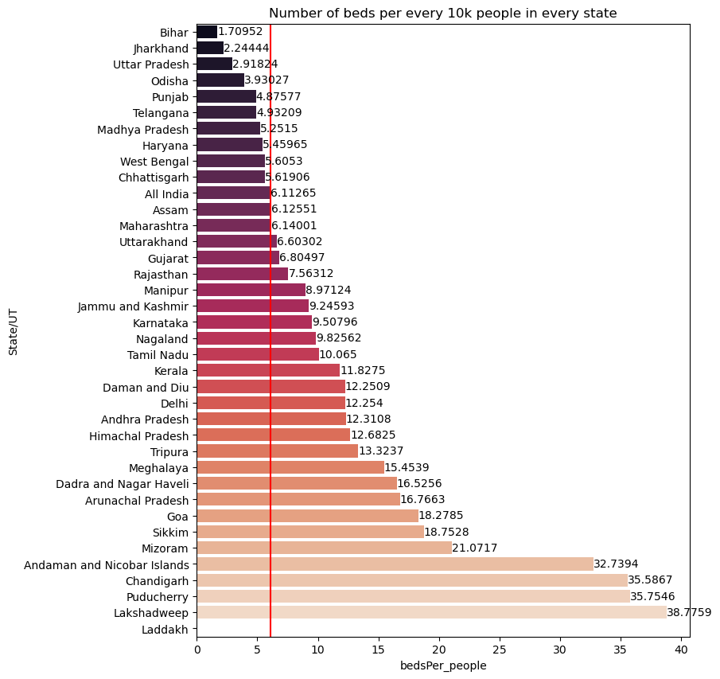
States which need more hospital beds at earliest
States with minimum hospital beds for every 10K people
Bihar
Jharkhand
Uttar Pradesh

Slide 14
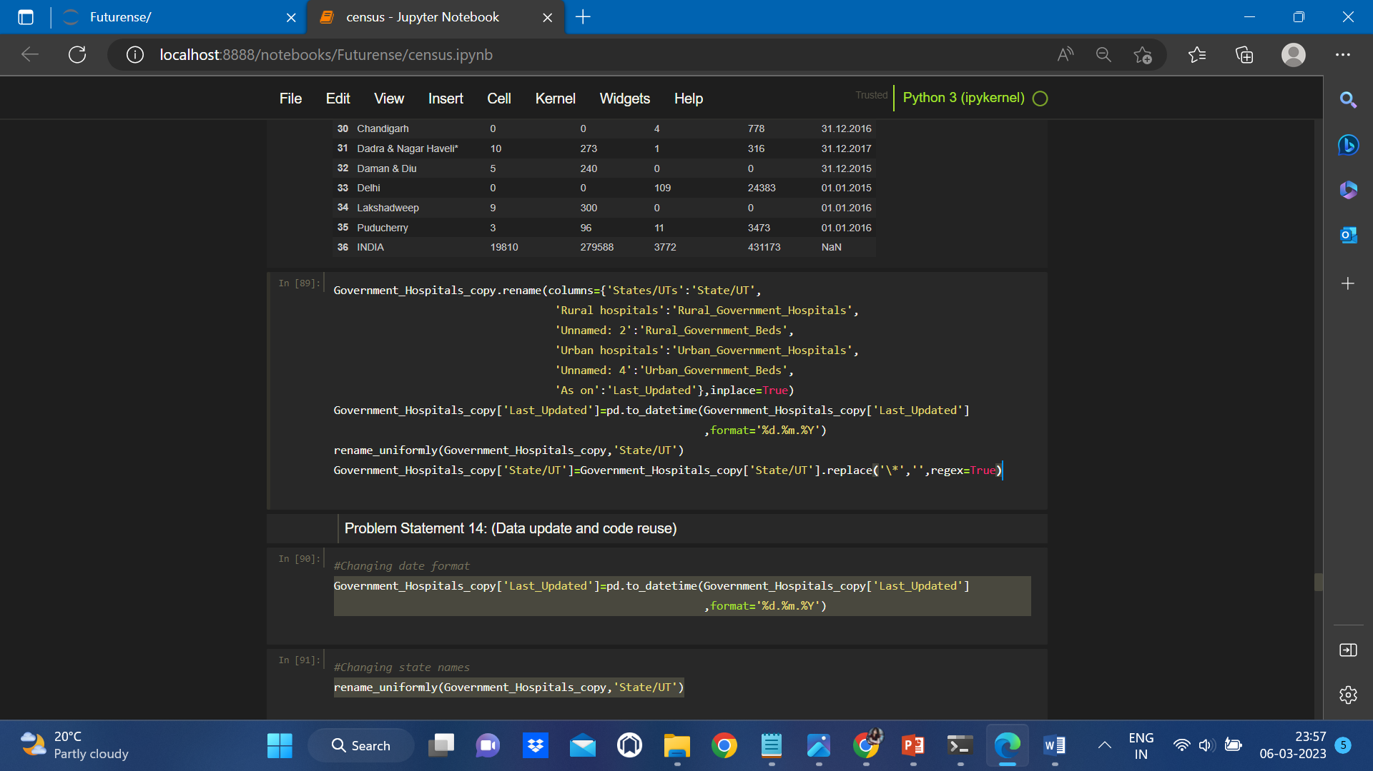
Government Hospitals Data
Preprocessing
Rename columns and State names for uniformity
Fix multi line header
Change date format

Slide 15
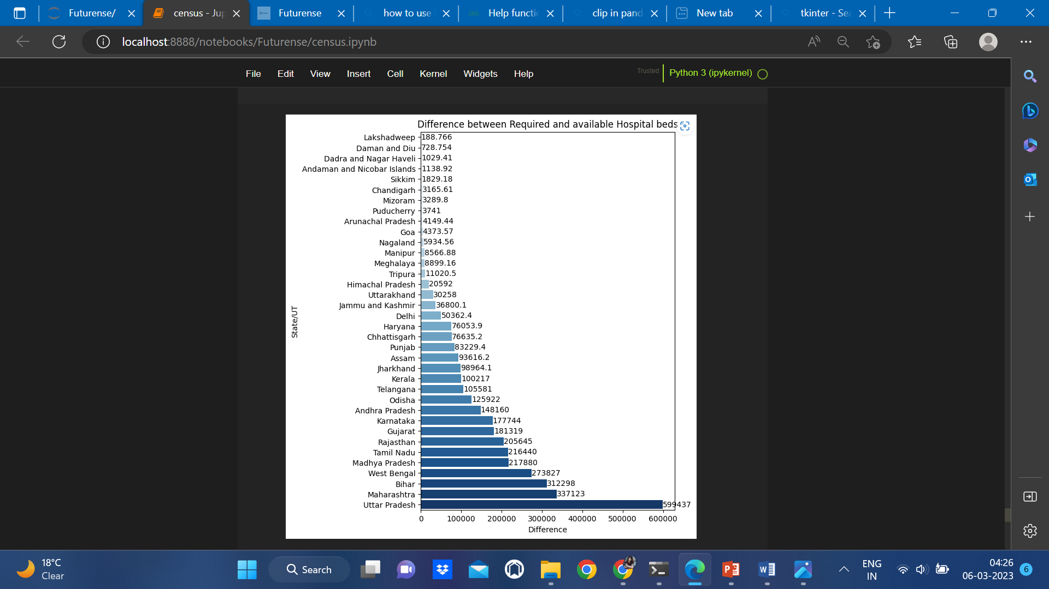
Difference between Required and Available hospital beds as per WHO Standards

Slide 16
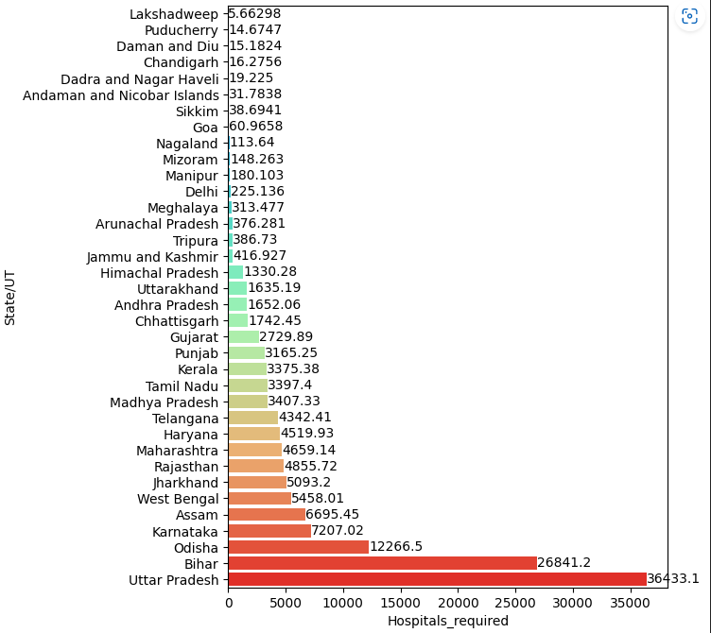
Government hospitals required to install to meet Standards

Slide 17
Highlights & Standout Features:
Create reusable functions for common data processing tasks, such as extracting basic information and renaming states and districts uniformly.
The BasicInfo function can extract essential information from every dataset, such as number of observations, variables, data types, and missing values.
The Rename function can standardize state and district names across all datasets, making it easier to merge and analyze data.
Use geospatial analysis tools like Geopandas to create informative visualizations and improve understanding of state-wise comparisons.

Slide 18
Optimization and Best Practices Used
Optimize data processing by leveraging the vectorization capabilities of Pandas instead of looping, which can improve performance and enable parallel processing.
Implement best practices for code reuse by creating user-defined functions to clean and transform dirty data frames. By modularizing code and separating concerns, we can improve code maintainability and reduce redundancy

Slide 19
Conclusions
3 States which need more hospital beds at the earliest
1. Bihar 2. Jharkhand 3. Uttar Pradesh
3 States which have more difference between required and available beds as per WHO standards
1. Uttar Pradesh 2. Maharashtra 3. Bihar
3 States which needs immediate installation of Hospitals
1. Uttar Pradesh 2. Bihar 3. Odisha
The analysis highlights the need for policymakers and stakeholders to focus on improving healthcare facilities in these states.
The government needs to invest in healthcare infrastructure, increase funding for healthcare, and encourage public-private partnerships to bridge the gap between required and available healthcare facilities.

Slide 20
Roadblocks
Insufficient data to calculate Urban to rural population ratio.
Private hospitals data is not available.

Slide 21
Future Scope:
Investigate correlations between different variables in the data, such as the relationship between hospital bed count and population density.
By comparing performance across states, we can identify best practices and areas for improvement, which can inform evidence-based policies and interventions.
Optimize code to increase efficiency and reduce processing time.

Slide 22
Thank You

Slide 23




















